Slide 1
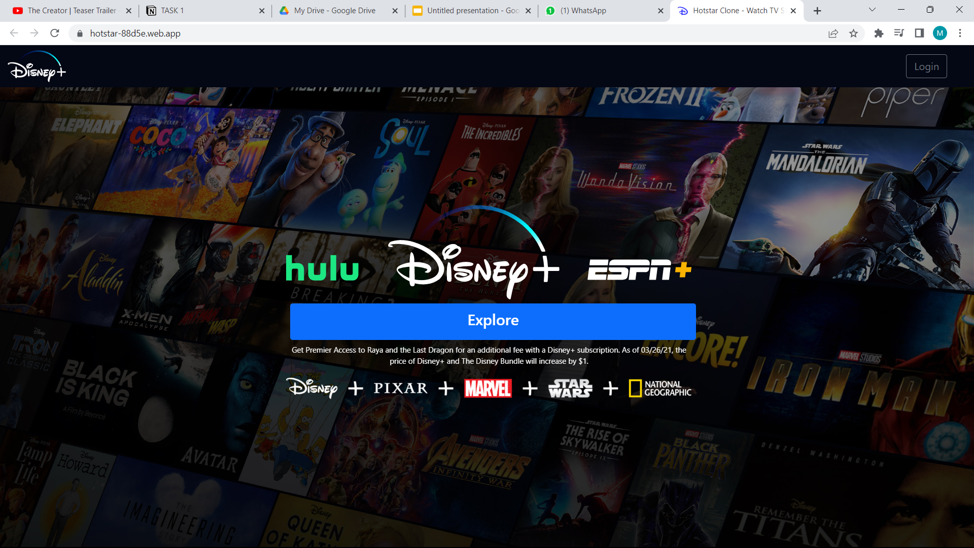
This will be your landing page on clicking explore button you need to redirect to your Home page.

Slide 2
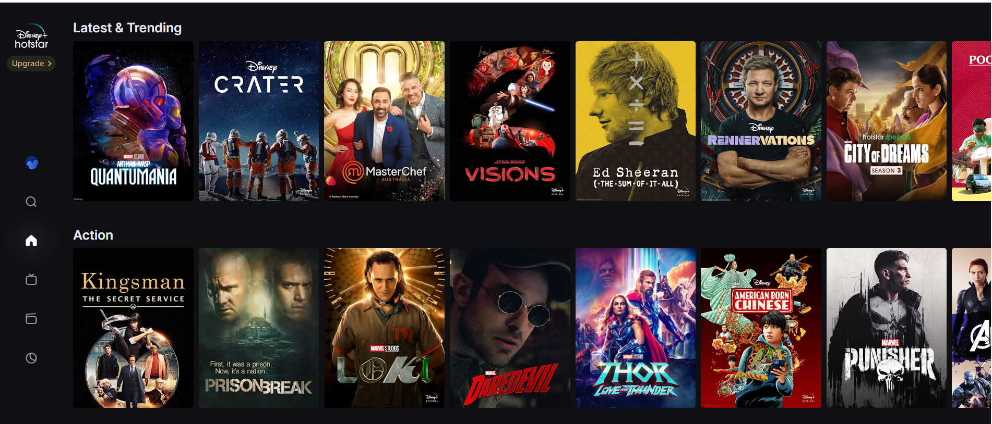
You must simulate a server by fetching Json data as demonstrated in the tutorial and display the movie card as seen in the above image. Don't worry; we'll give you the essential JSON data, though you'll need to make a few adjustments later on in the course.

Slide 3
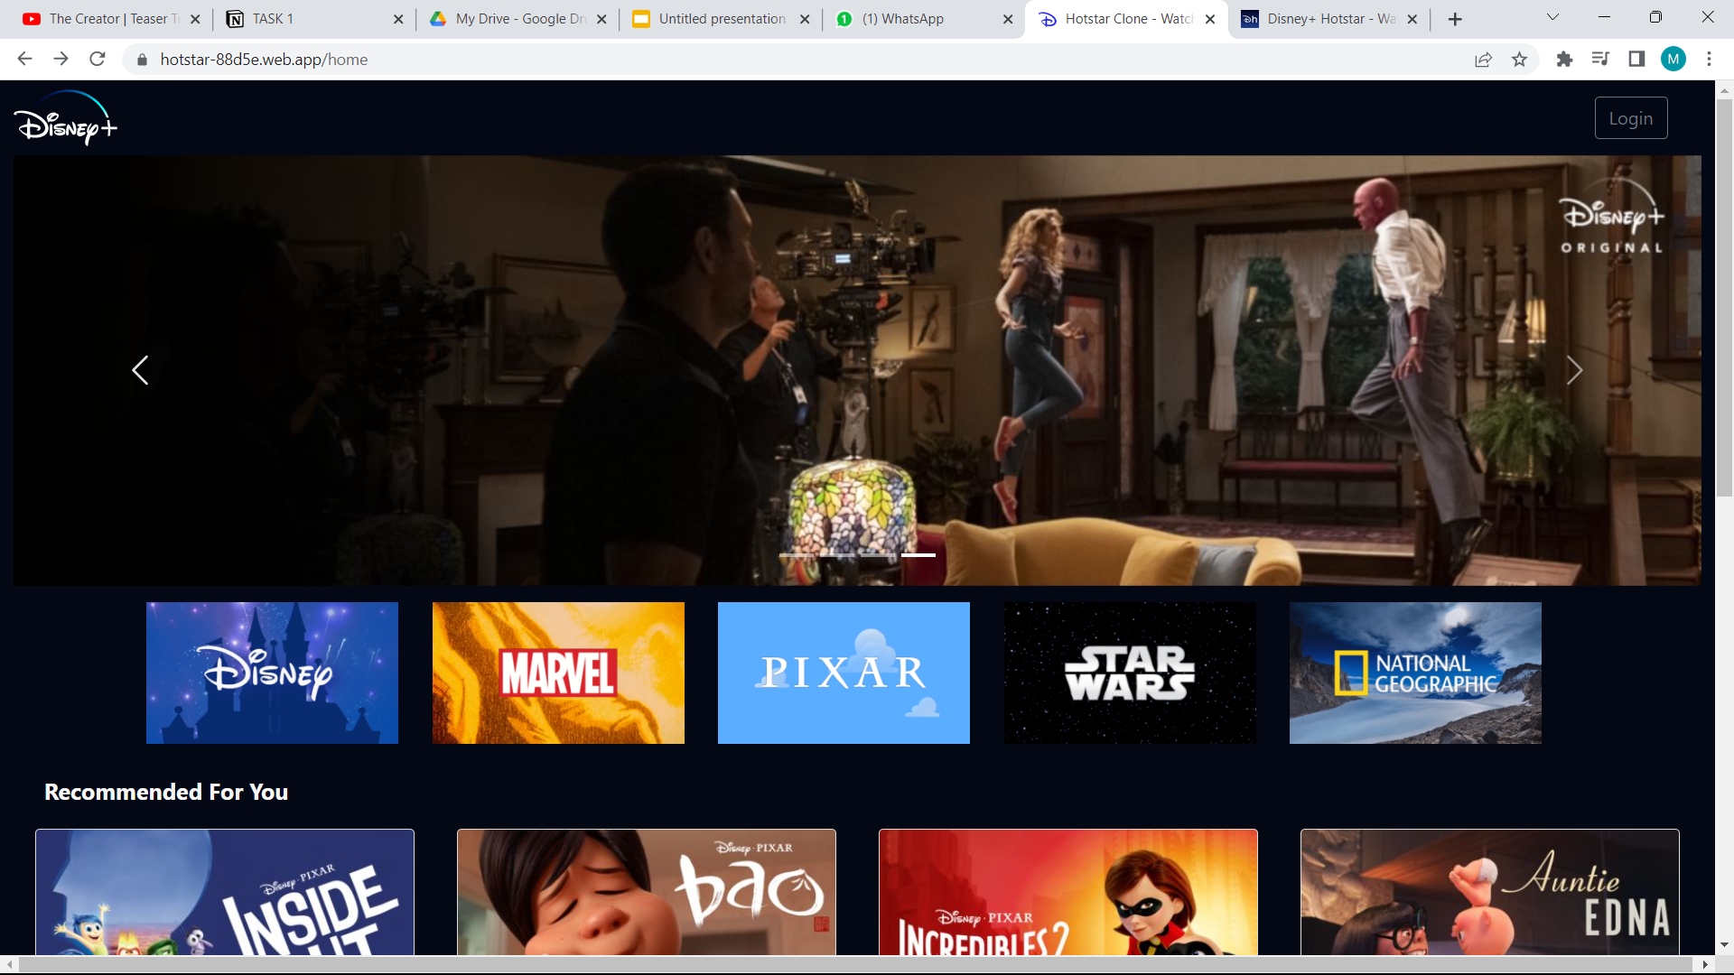
For neat appearance,It is recommended to add slider kind of image above movies section as shown by red box in above image.Your homepage will be formed by the combination of slides 2 and 3, along with the footer.

Slide 4
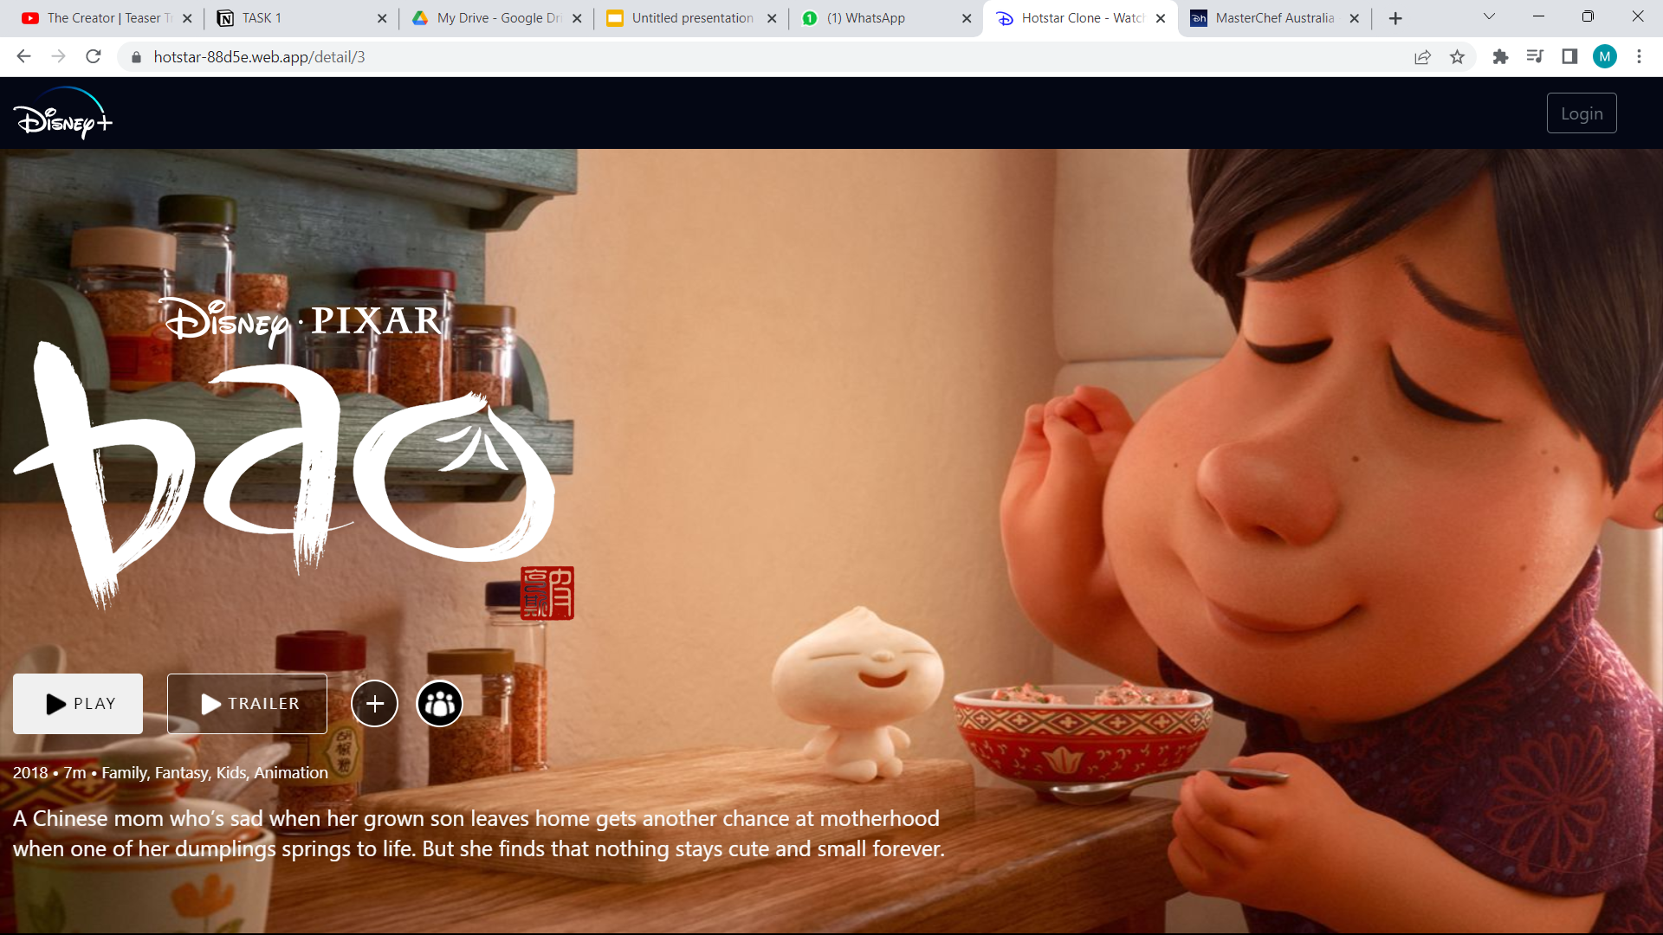
You must create a static page as shown above for any movie of your choice(not necessarily from the json data provided) with path “/home/movie” which for now can be accessed by clicking on TV icon in sidebar .You don’t need to add the team icon given in the image shown with brown box.

Slide 5
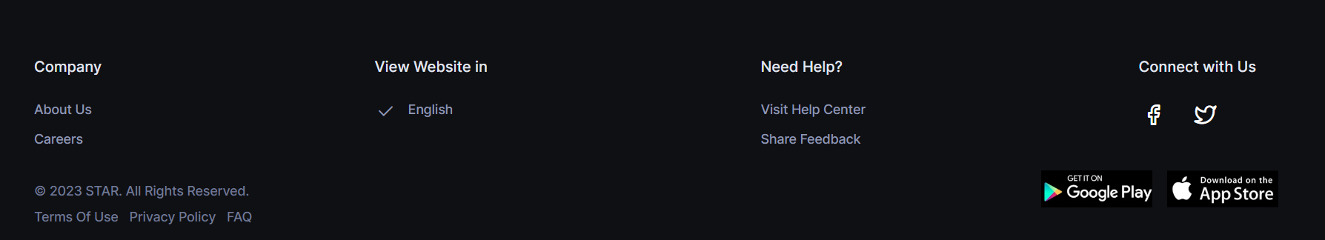
FOOTER
You can skip the section in blue box of the image

